Slide 1
Machine Learning
Instructors: Bens Bernard
Hope everyone stays safe and healthy in these difficult times!

Slide 2
Topics Covered in This Course

Slide 3
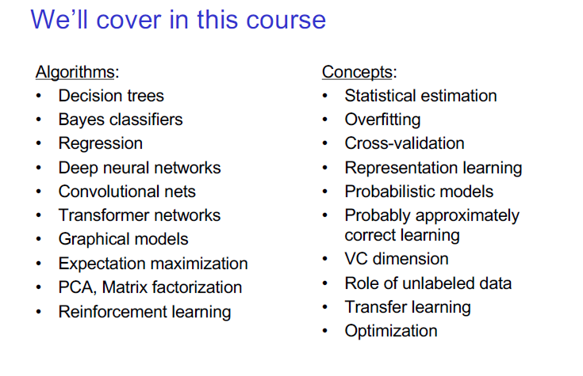

Slide 4

Pre-requisite
Probability
distribution, random variable, expectation, conditional probability, variance, density
Linear algebra
matrix multiplication
eigenvector (Vecteur propre)
Basic programming (in Python)
This is a mathematically intense course.
But that’s why it’s exciting and rewarding!
Notes:
Mention that we will use whiteboard for the rest of the course

Slide 5
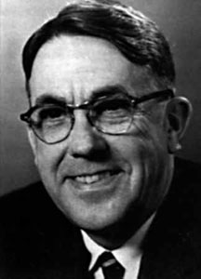
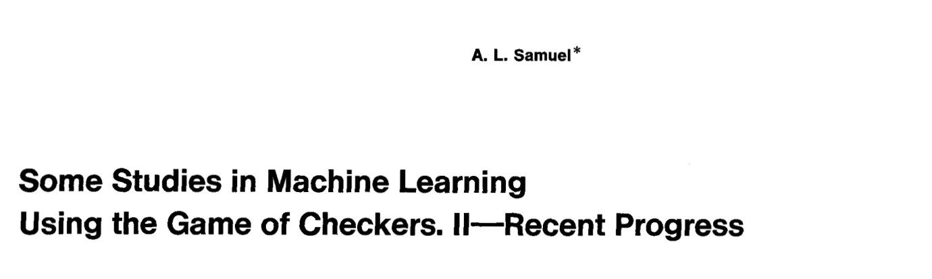
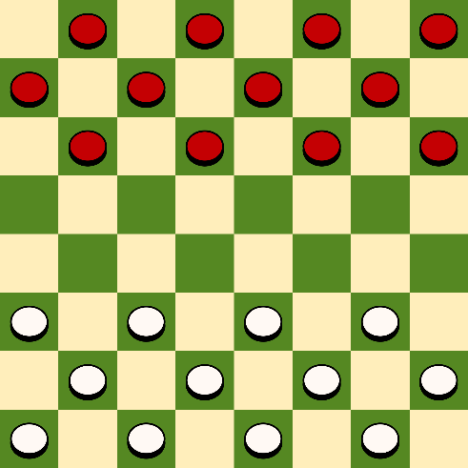
Definition of Machine Learning
Arthur Samuel (1959): Machine Learning is the field of study that gives the computer the ability to learn without being explicitly programmed.
Photos from Wikipedia

Slide 6
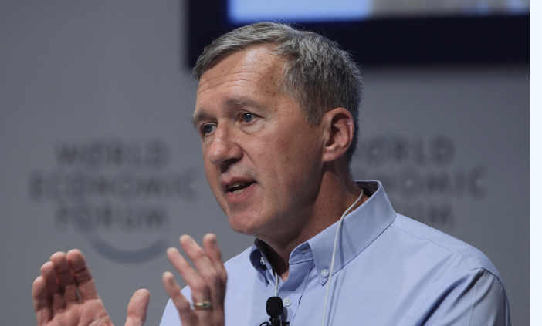
Definition of Machine Learning
Tom Mitchell (1998): a computer program is said to learn from experience E with respect to some class of tasks T and performance measure P, if its performance at tasks in T, as measured by P, improves with experience E.
Experience (data): games played by the program (with itself)
Performance measure: winning rate
Image from Tom Mitchell’s homepage

Slide 7
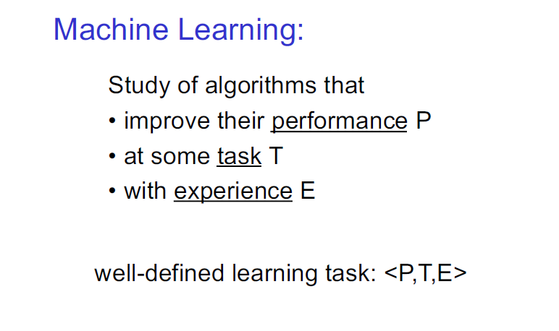

Slide 8
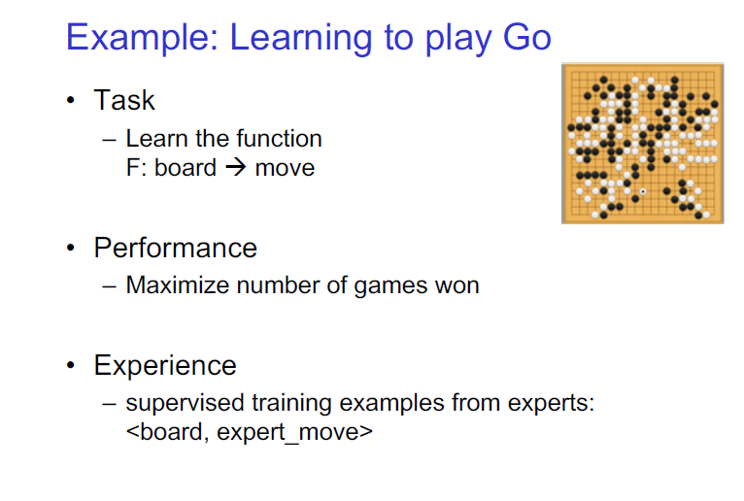

Slide 9
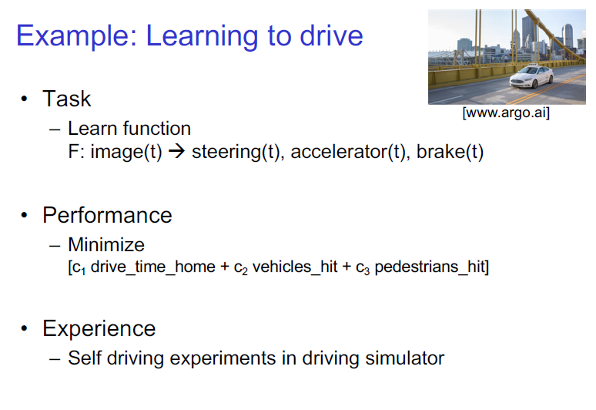

Slide 10
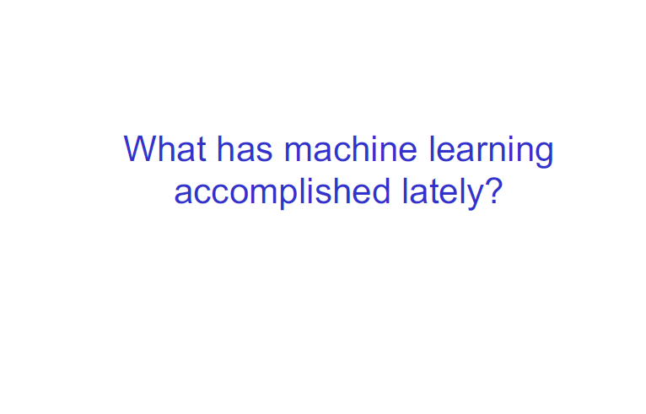

Slide 11
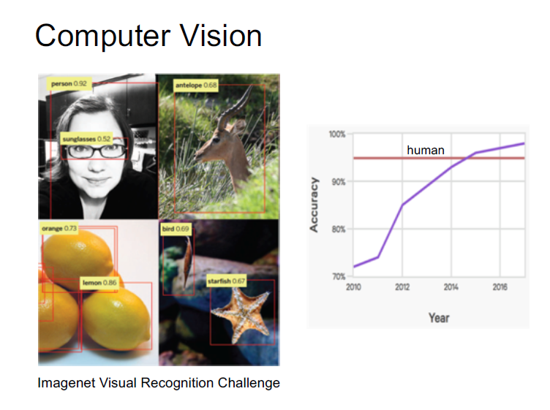

Slide 12
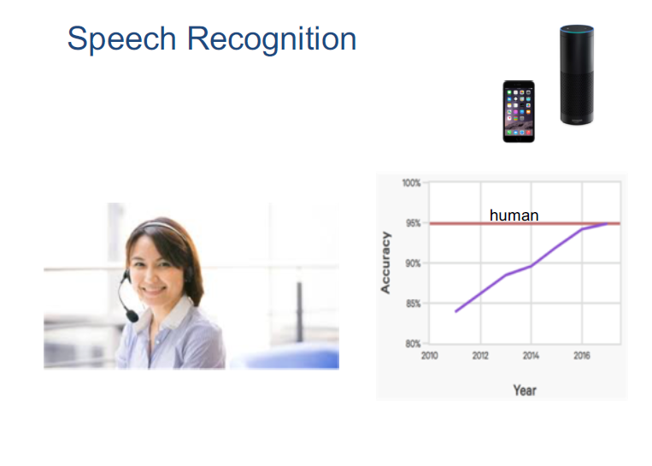

Slide 13
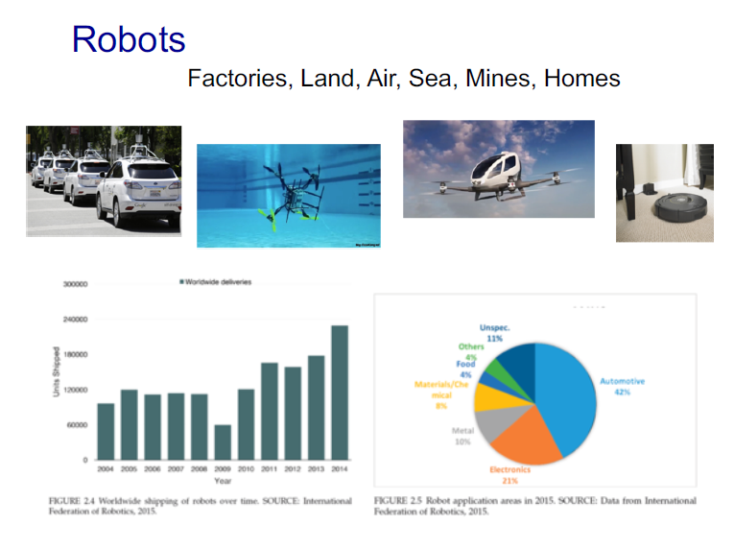

Slide 14
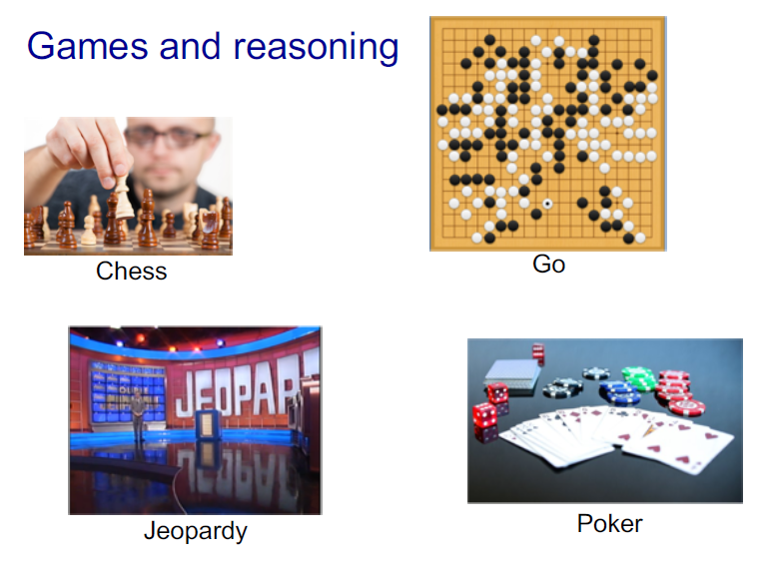

Slide 15
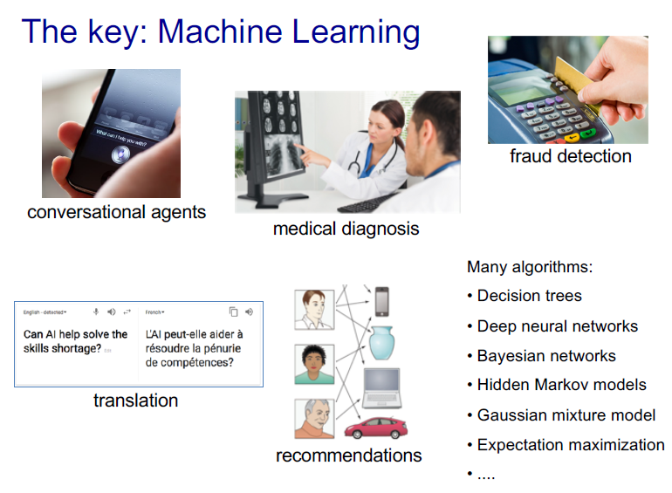

Slide 16
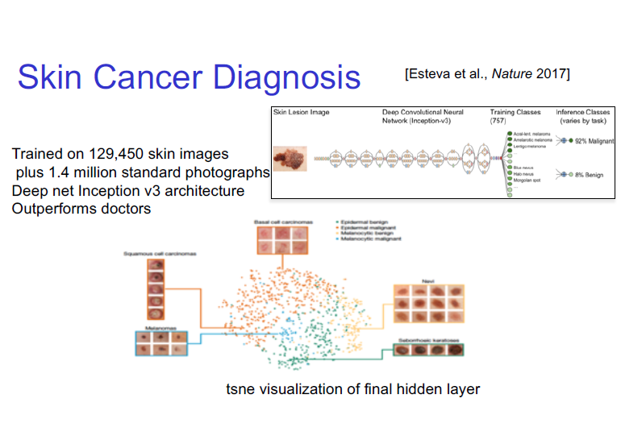

Slide 17
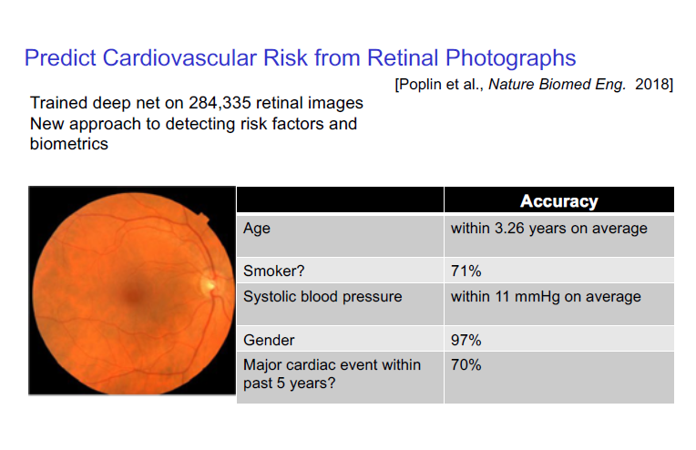

Slide 18
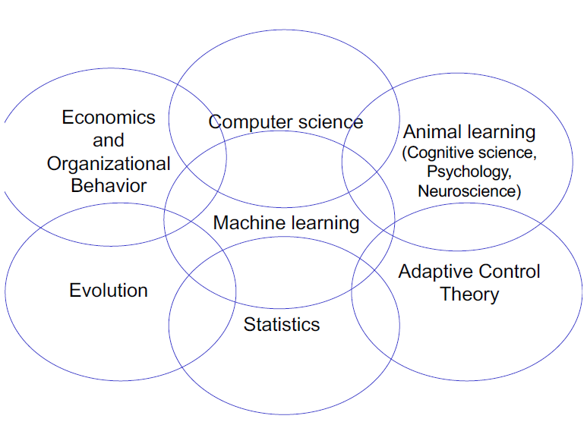

Slide 19
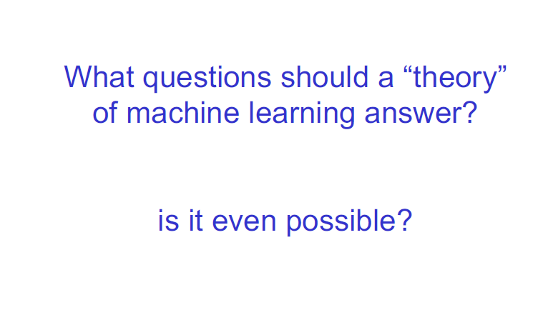

Slide 20
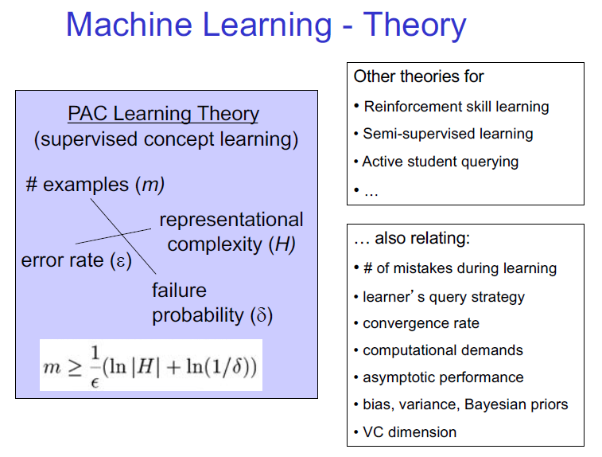

Slide 21
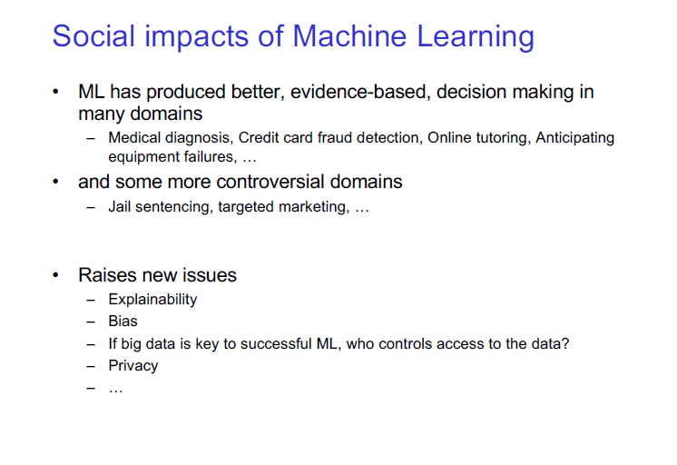

Slide 22
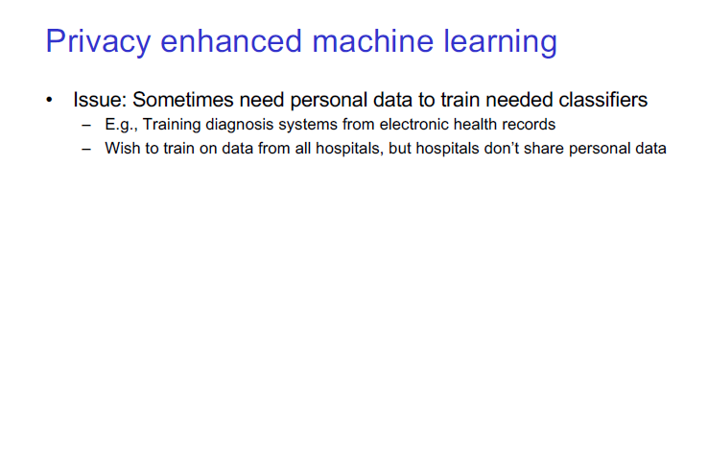

Slide 23
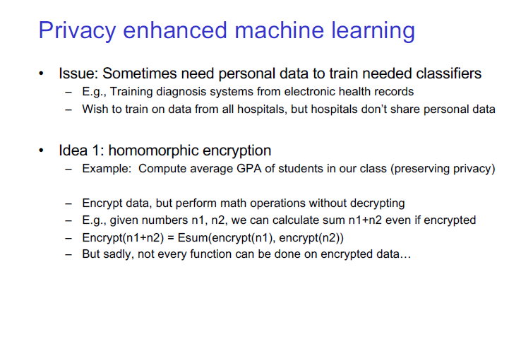

Slide 24
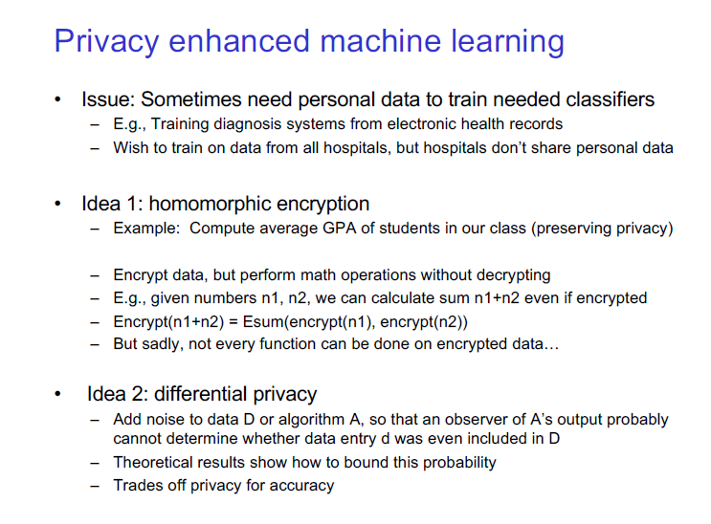

Slide 25
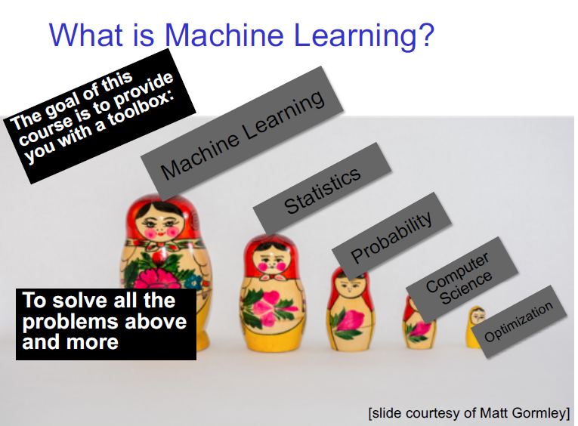

Slide 26
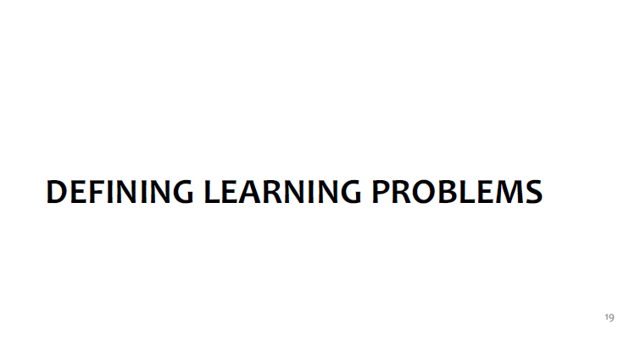

Slide 27
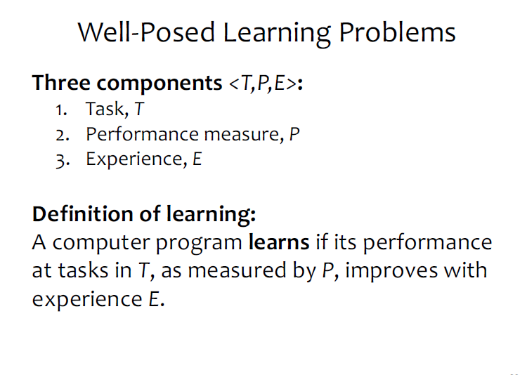

Slide 28
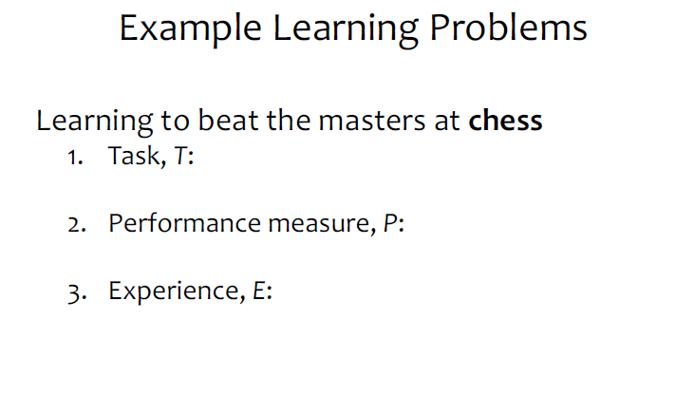

Slide 29
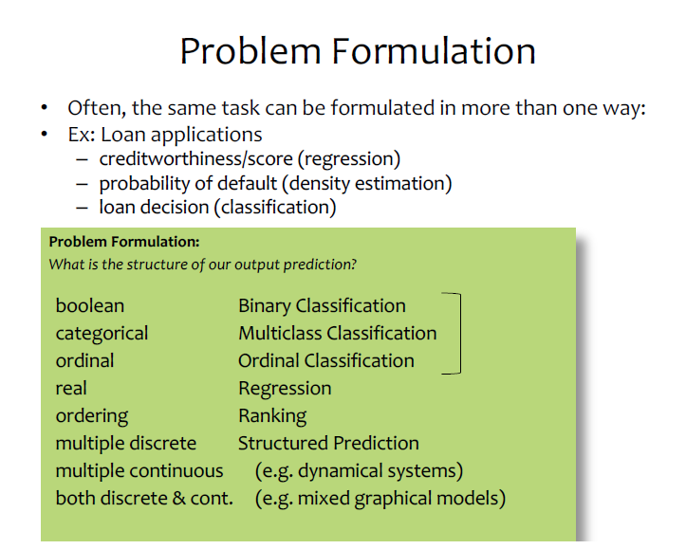

Slide 30
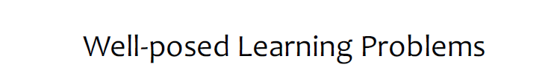

Slide 31
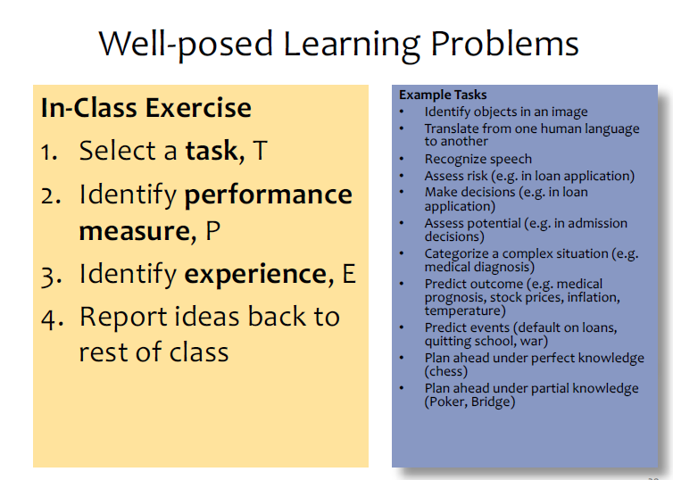

Slide 32
Taxonomy of Machine Learning (A Simplistic View Based on Tasks)
Supervised
Learning
Unsupervised
Learning
Reinforcement
Learning
can also be viewed as tools/methods

Slide 33
Supervised Learning

Slide 34
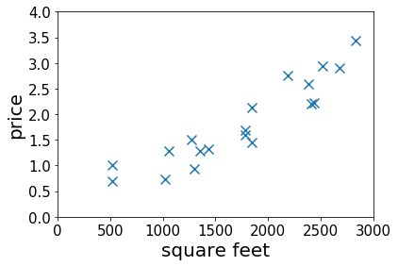
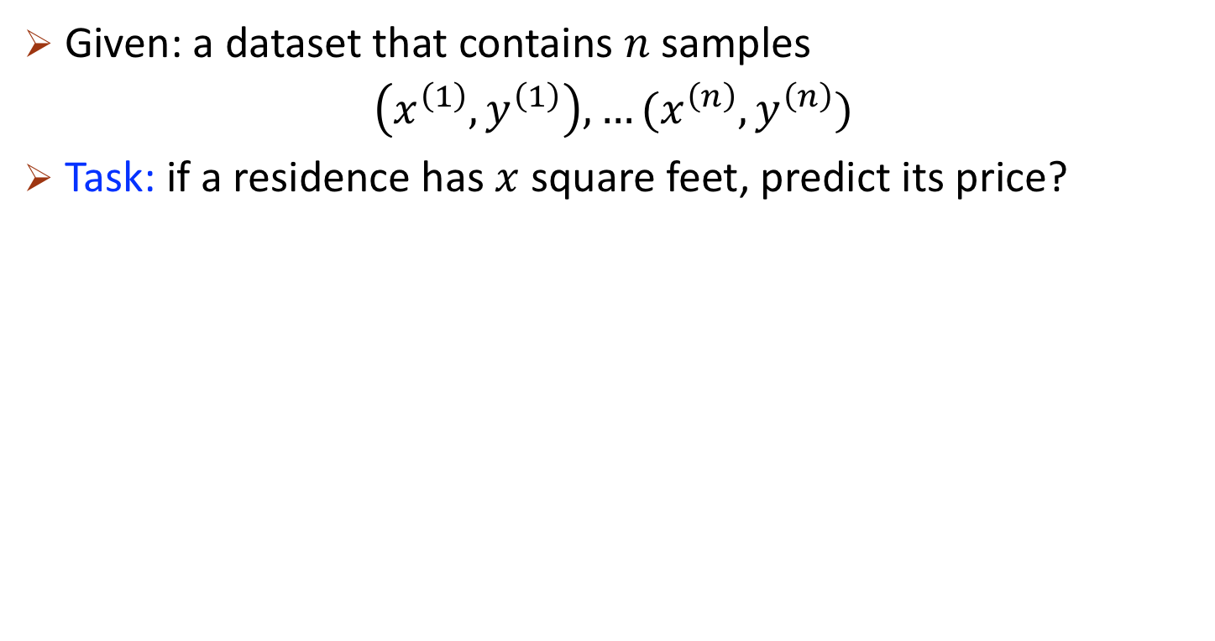
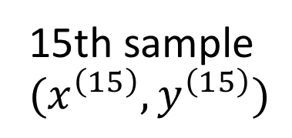
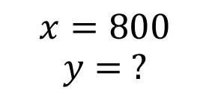
Housing Price Prediction
Given: a dataset that contains $n$ samples
$\left(x^{\left(1\right)},y^{\left(1\right)}\right), …(x^{\left(n\right)},y^{\left(n\right)})$
Task: if a residence has $x$ square feet, predict its price?
15th sample $(x^{\left(15\right)},y^{\left(15\right)})$
$$x=800$$
$$y= ?$$
Notes:
Mention the dataset is the experience

Slide 35
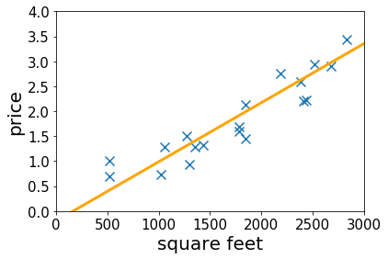
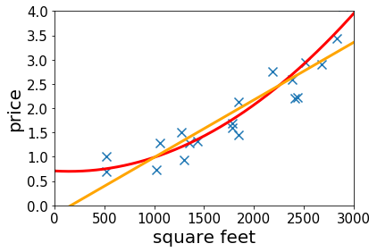
Housing Price Prediction
Given: a dataset that contains $n$ samples
$\left(x^{\left(1\right)},y^{\left(1\right)}\right), …(x^{\left(n\right)},y^{\left(n\right)})$
Task: if a residence has $x$ square feet, predict its price?
$$x=800$$
$$y= ?$$
Lecture 2&3: fitting linear/qaudratic functions to the dataset
Notes:
Mention the dataset is the experience

Slide 36
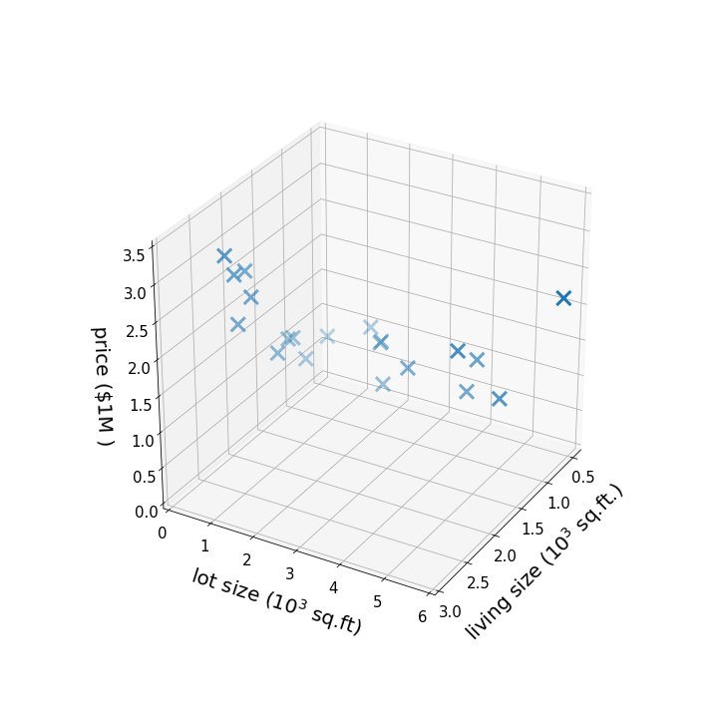
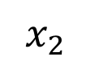
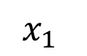
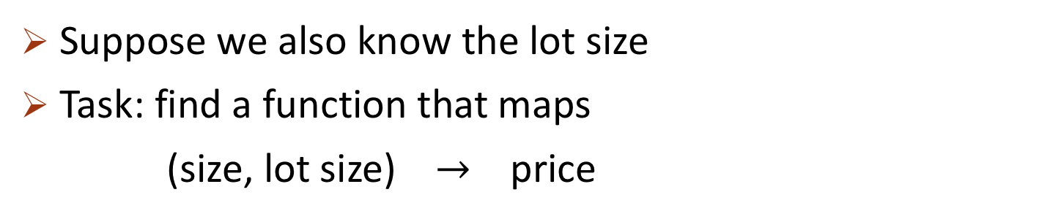
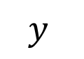
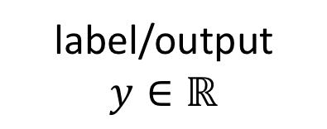
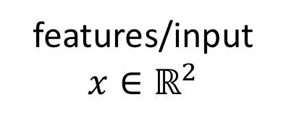
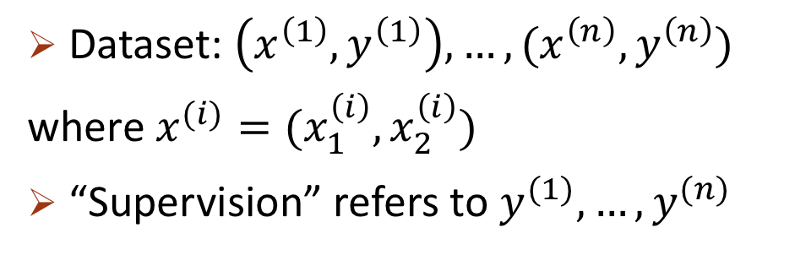
More Features
Suppose we also know the lot size
Task: find a function that maps
(size, lot size) $→$ price
features/input
$$x∈ℝ^{2}$$
label/output
$$y∈ℝ$$
$$y$$
Dataset: $\left(x^{\left(1\right)},y^{\left(1\right)}\right), …,(x^{\left(n\right)},y^{\left(n\right)})$
where $x^{(i)}=(x_{1}^{\left(i\right)},x_{2}^{\left(i\right)})$
“Supervision” refers to $y^{(1)},…, y^{(n)}$
$$x_{2}$$
$$x_{1}$$

Slide 37
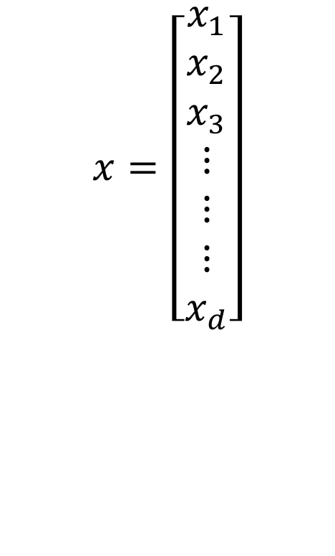

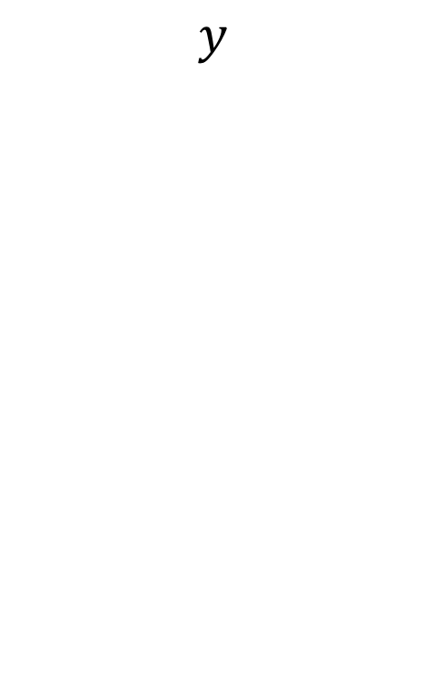
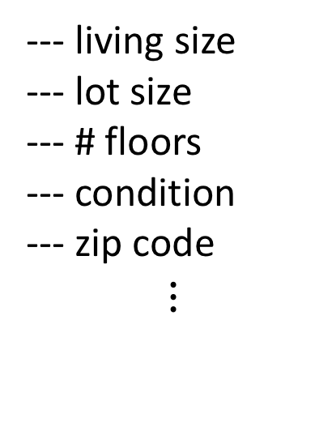
High-dimensional Features
$x∈ℝ^{d}$ for large $d$
E.g.,
--- living size
--- lot size
--- # floors
--- condition
--- zip code
$$⋮$$
$$x=\left[\begin{aligned}x_{1} \\ x_{2} \\ x_{3} \\ ⋮ \\ ⋮ \\ ⋮ \\ x_{d}\end{aligned}\right]$$
--- price
$$y$$
Lecture 6-7: infinite dimensional features
Lecture 10-11: select features based on the data

Slide 38
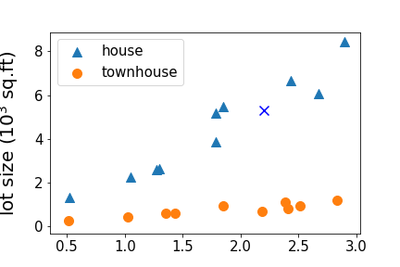
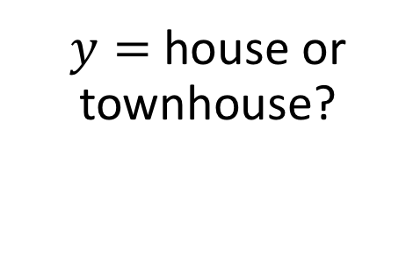
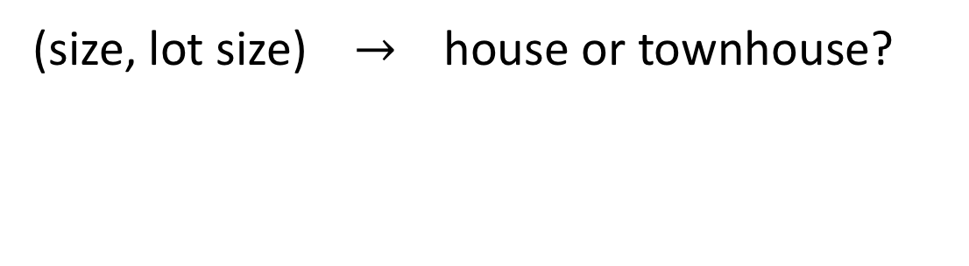

Regression vs Classification
regression: if $y∈ℝ$ is a continuous variable
e.g., price prediction
classification: the label is a discrete variable
e.g., the task of predicting the types of residence
(size, lot size) $→$ house or townhouse?
$y=$ house or townhouse?
Lecture 3&4: classification
Notes:
House vs townhouse

Slide 39


Supervised Learning in Computer Vision
Image Classification
$x=$ raw pixels of the image, $y=$ the main object
ImageNet Large Scale Visual Recognition Challenge. Russakovsky et al.’2015

Slide 40


Supervised Learning in Computer Vision
Object localization and detection
$x=$ raw pixels of the image, $y=$ the bounding boxes
ImageNet Large Scale Visual Recognition Challenge. Russakovsky et al.’2015

Slide 41



Supervised Learning in Natural Language Processing
Machine translation
$$x$$
$$y$$
Note: this course only covers the basic and fundamental techniques of supervised learning (which are not enough for solving hard vision or NLP problems.)
NLP course would be more suitable if you are interested in the particular applications

Slide 42
Unsupervised Learning

Slide 43



Unsupervised Learning
Dataset contains no labels: $x^{\left(1\right)}, …x^{\left(n\right)}$
Goal (vaguely-posed): to find interesting structures in the data
supervised
unsupervised

Slide 44
Clustering

Slide 45
Clustering
Lecture 12&13: k-mean clustering, mixture of Gaussians

Slide 46

Clustering Genes
Cluster 1
Cluster 7
Genes
Individuals
Identifying Regulatory Mechanisms using Individual Variation Reveals Key Role for Chromatin Modification. [Su-In Lee, Dana Pe'er, Aimee M. Dudley, George M. Church and Daphne Koller. ’06]

Slide 47

Latent Semantic Analysis (LSA)
documents
words
Lecture 14: principal component analysis (tools used in LSA)
Image credit: https://commons.wikimedia.org/wiki/File:Topic_
detection_in_a_document-word_matrix.gif

Slide 48



Word Embeddings
models
Unlabeled dataset
Represent words by vectors
word
$\underset{→}{encode }$
vector
relation
$\underset{→}{encode }$
direction
Rome
Paris
Italy
Berlin
France
Germany
Word2vec [Mikolov et al’13] GloVe [Pennington et al’14]
Notes:
Define vectors

Slide 49


Clustering Words with Similar Meanings (Hierarchically)
[Arora-Ge-Liang-M.-Risteski, TACL’17,18]

Slide 50
Reinforcement Learning

Slide 51

learning to walk to the right
Iteration 10
[Luo-Xu-Li-Tian-Darrell-M.’18]

Slide 52

learning to walk to the right
Iteration 20
[Luo-Xu-Li-Tian-Darrell-M.’18]

Slide 53

learning to walk to the right
Iteration 80
[Luo-Xu-Li-Tian-Darrell-M.’18]

Slide 54

learning to walk to the right
Iteration 210
[Luo-Xu-Li-Tian-Darrell-M.’18]

Slide 55
Reinforcement Learning
The algorithm can collect data interactively
Try the strategy and collect feedbacks
Data collection
Training
Improve the strategy based on the feedbacks

Slide 56
Taxonomy of Machine Learning (A Simplistic View Based on Tasks)
Supervised
Learning
Unsupervised
Learning
Reinforcement
Learning
can also be viewed as tools/methods

Slide 57

Other Tools/Topics In This Course
Deep learning basics
Introduction to learning theory
Bias variance tradeoff
Feature selection
ML advice
Broader aspects of ML
Robustness/fairness

Slide 58
Questions?
Thank you!

Slide 59
My Group’s Research: Machine Learning Tools/Theory
How do we
train faster?
pick the correct model (and hyperparameters)?
regularize the models so that they can generalize with fewer samples to unseen scenarios?
robustify the models?
Various settings:
supervised learning
unsupervised learning
reinforcement learning

Slide 60



Reinforcement Learning

Slide 61


Slide 62


Slide 63


Slide 64


Slide 65


Slide 66


Slide 67


Slide 68


Slide 69


Slide 70


Slide 71


Slide 72


Slide 73


Slide 74


Slide 75


Slide 76


Slide 77


Slide 78


Slide 79


Slide 80


Slide 81


Slide 82


Slide 83


Slide 84


Slide 85


Slide 86


Slide 87


Slide 88


Slide 89


Slide 90


Slide 91


Slide 92


Slide 93


Slide 94


Slide 95


Slide 96


